Slide 1
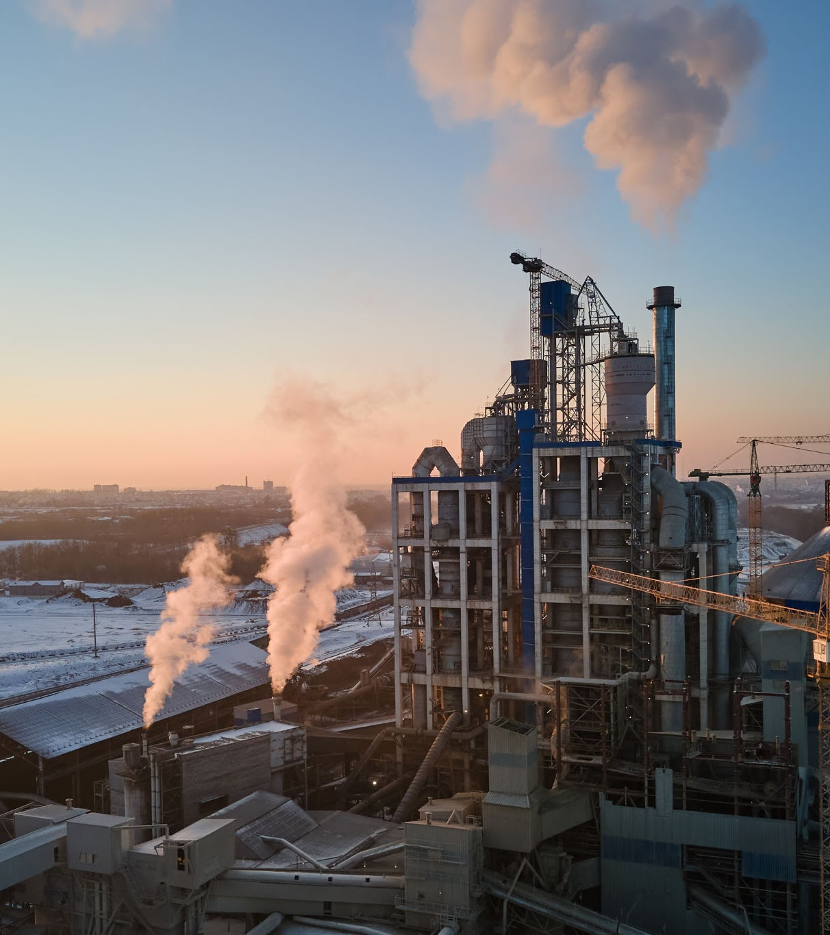
Chemical Engineering

Slide 2
Overview
What is Chemical Engineering?
Oil and Gas
College Work and Post Grad
My Job
Popular Industries
Academia and Others

Slide 3
What is Chemical Engineering?
A broad discipline of engineering involving the conceiving and design of processes to produce, transform, and transport materials.
This discipline covers all portions of this process, from conception to laboratory testing to full scale manufacturing
The work can be done in the lab, in an office, or on the field
This field is used to solve global and societal issues, provide energy, and develop a wide variety of products and technologies

Slide 4
College Work and Post Grad Paths
The foundation of chemical engineering is chemistry, physics, and math (if you are good at these, this job is for you)
Courses: Thermodynamics, Heat Transfer, Fluid Mechanics, Separation Technologies, Reactor Design and Lab, Process Design, Applied Maths
Post Graduation Paths: Industry, Academia, Other (ex. Consulting, Law, Medicine, Finance, etc.)

Slide 5
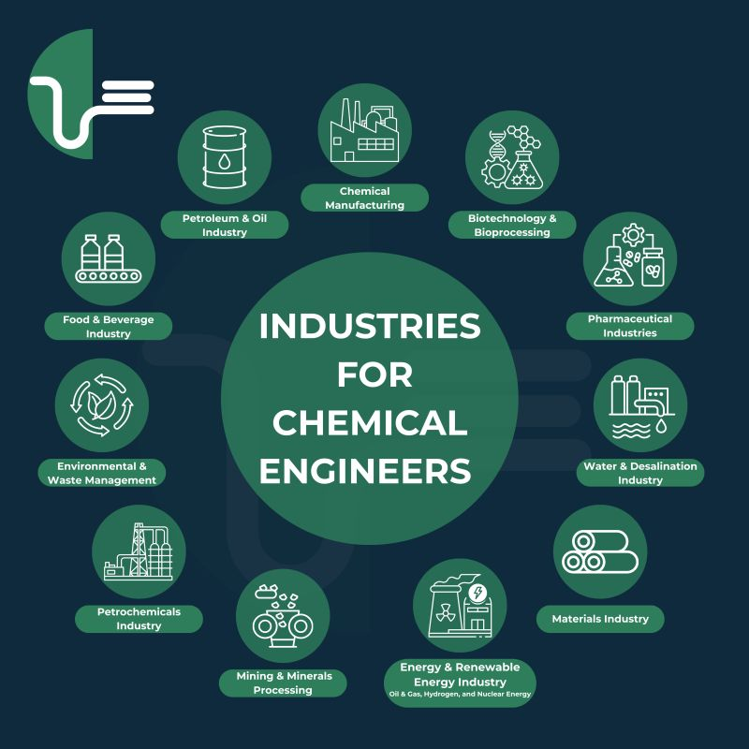
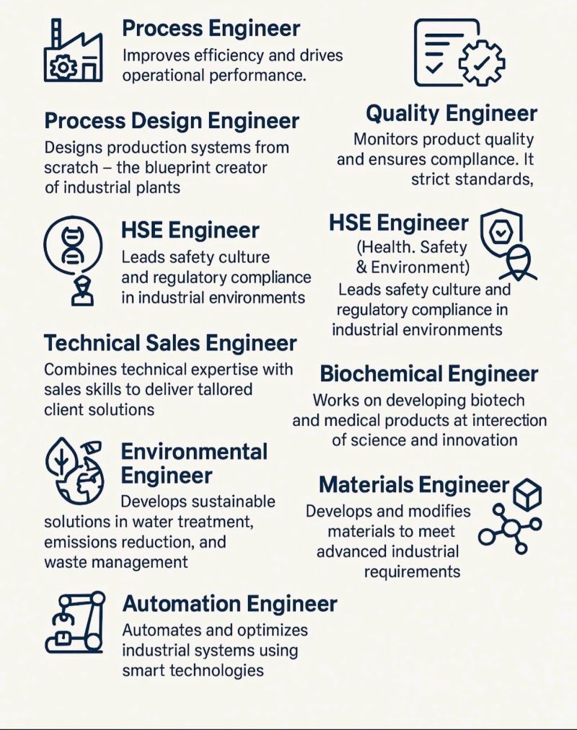
Popular Industries

Slide 6
Oil and Gas
Chem Eng play a central role in all stages of oil and gas production
  Upstream (exploration and production)
  Midstream (transportation and storage)
  Downstream (refining and petrochemicals)
Key Responsibilities:
  Process optimization: Improving energy efficiency and throughput
  Equipment design: From heat exchangers to reactors, they ensure optimal operation and safety
  Safety & environmental compliance: Implementing systems to reduce emissions and hazardous waste
  Troubleshooting & innovation: Solving real-time production issues while integrating modern technologies
Work Place: Field jobs or office jobs

Slide 7
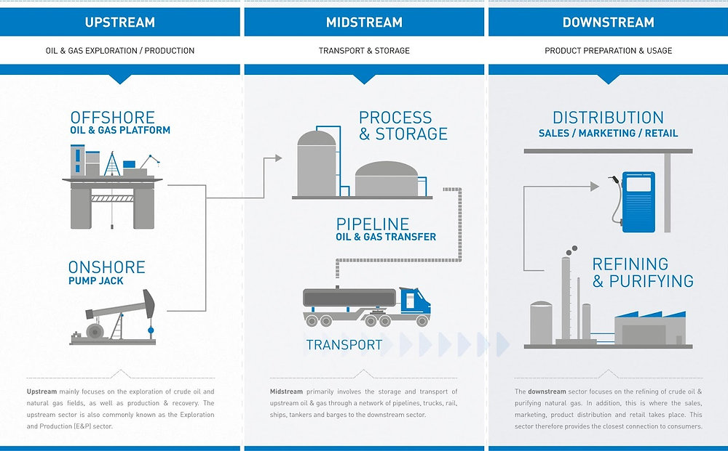
Oil and Gas

Slide 8
My Job
I work as a process engineer at NextDecade, a liquified natural gas company
I am responsible for designing, optimizing, and overseeing the processes involved in converting natural gas into its liquid form for storage and transportation
Projects:
  Model and optimize the hot oil system to make it more efficient
  Develop and optimize multiple PSV depressurization scenarios
I work on carbon capture projects and have even contributed to research papers at the company

Slide 9
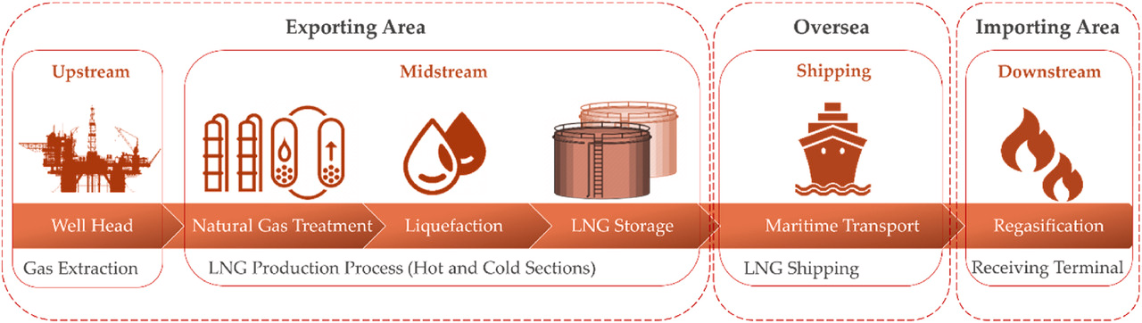
My Job: LNG Process

Slide 10
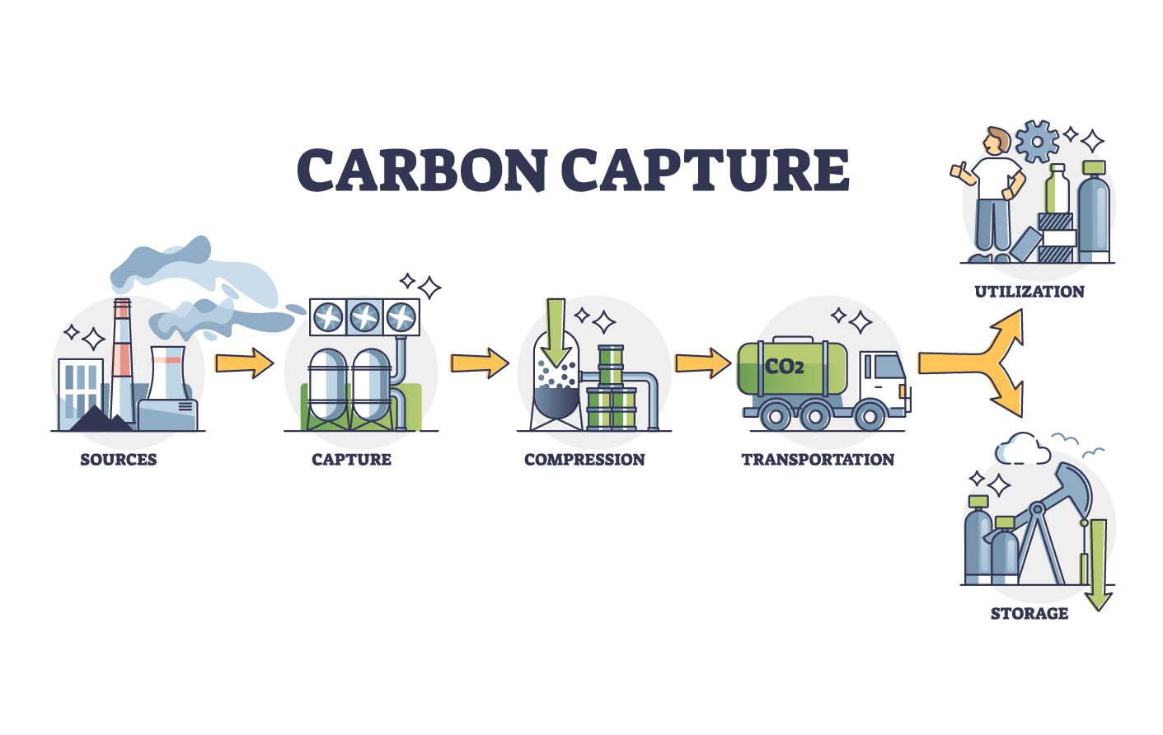
My Job: Carbon Capture Process

Slide 11
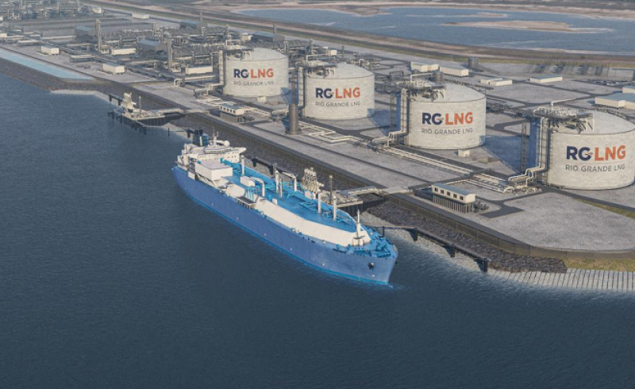
My Job: RGLNG

Slide 12
Academia and Others
PhD: A 5-6 year program for advanced and specialized careers in R&D in industry, government, and academia.
Masters: An advanced degree (typically 2 years) that gives you a deeper understanding of chemical engineering that allows you access to both higher level positions in industry and academia
Other: The wide skill set learned in a chemical engineering degree can be used in other industries, such as medicine, law, consulting, IT, etc. You are not limited to traditional roles!

Slide 13
My Advice and Questions
Consider if you like math, physics, and chemistry, cause there is a lot of it!
Sharpen your excel skills as much as possible. The corporate world loves it!
Think about the degree as a problem solving degree, rather than engineering.
Explore different courses outside of your major in undergrad.
You are young and the world is your oyster! This might feel like the end all be all decision but it is not. Don’t be afraid to try and fail and try and fail.

